Slide 1
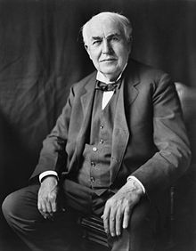
Thomas Alva Edison

Slide 2
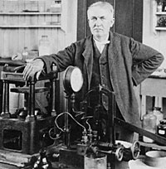
Quotes
“Many of life's failures are people who did not realize how close they were to success when they gave up.”
― Thomas A. Edison
“Five percent of the people think;
ten percent of the people think they think;
and the other eighty-five percent would rather die than think.”
― Thomas A. Edison

Slide 3
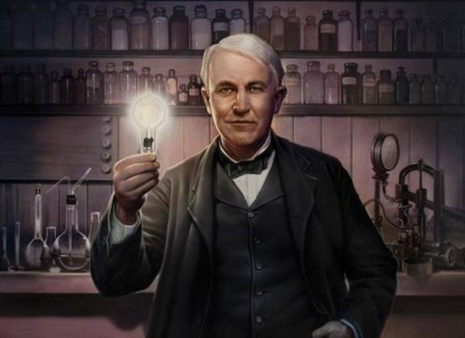
invention
Thomas Edison was an American inventor and businessman, who has been described as America's greatest inventor. He is credited with developing many devices in fields such as electric power generation, mass communication, sound recording, and motion pictures. These inventions, which include the phonograph, the motion picture camera, and the long-lasting, practical electric light bulb, had a widespread impact on the modern industrialized world. He was one of the first inventors to apply the principles of mass production and teamwork to the process of invention. He is often credited with establishing the first industrial research laboratory. Passionate about electricity, he is the inventor of cinema. In addition, we call him « the sorcerer of Menlo Park ».

Slide 4
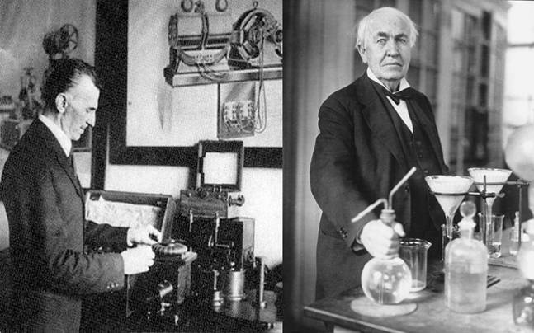
A part of his life
Edison became embroiled in a longstanding rivalry with Nikola Tesla, an engineering visionary with academic training who worked with Edison's company for a time. The two parted ways in 1885.

Slide 5
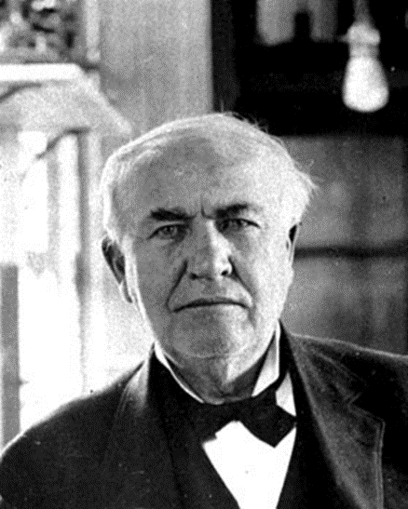
The impact of this creator
Edison invented of refined devices that made a profound impact on how people lived. The most famous of his inventions was the incandescent light bulb (in 1878), which would revolutionize indoor lighthing and forever separate light from fire.

